Slide 1
ECE408/CS483/CSE408 Spring 2018 Applied Parallel Programming Lecture 3: Kernel-Based Data Parallel Execution Model

Slide 2
Obejctive
To learn more on the logical multi-dimensional organization of CUDA threads
To learn to use control structures like loops in a kernel
To learn the concept of thread scheduling, latency tolerance, and hardware occupancy

Slide 3
Review – Thread Assignment for vecAdd where N = 1,000, block size = 256
vecAdd<<<ceil(N/256.0), 256>>>(…)
i = blockIdx.x * blockDim.x + threadIdx.x;
C[i] = A[i] + B[i];
Thread Block 0
Thread Block 1
Thread Block gridDim.x-1
0
1
2
254
255
0
1
2
254
255
0
1
2
254
255
…
…
…
…
…
…
i = 0*256+ 0 = 0
i = 1*256 + 0 = 256
i = 3*256 + 0 = 768
…

Slide 4
Review – Thread Assignment for vecAdd Each thread processes 2 elements (Q4)
vecAdd<<<ceil(N/(2*256.0)), 256>>>(…)
i = blockIdx.x * (2*blockDim.x) + threadIdx.x;
C[i] = A[i] + B[i];
Thread Block 0
Thread Block 1
0
1
2
254
255
0
1
2
254
255
…
…
…
…
…
i = 0*256+ 0 = 0
i = 2*256 + 0 = 768
…

Slide 5
Review – Thread Assignment for vecAdd Each thread processes 2 elements (Q4)
vecAdd<<<ceil(N/(2*256.0)), 256>>>(…)
i = blockIdx.x * (2*blockDim.x) + threadIdx.x;
C[i] = A[i] + B[i];
i = i+blockDim.x;
C[i] = A[i] + B[i];
Thread Block 0
Thread Block 1
0
1
2
254
255
0
…
…
i = 1*256+ 0 = 0
i = 3*256 + 0 = 768

Slide 6
CUDA Thread Grids are Multi-Dimensional
host
device
Grid 1
Block (0, 0)
Block (0, 1)
Kernel 1
Block (1, 0)
Block (1, 1)
Block (1,1)
(1,0,0)
(1,0,1)
(1,0,2)
(1,0,3)
Thread
(0,0,0)
Thread
(0,0,1)
Thread
(0,0,2)
Thread
(0,0,3)
Thread
(0,0,0)
Thread
(0,1,3)
Thread
(0,1,0)
Thread
(0,1,1)
Thread
(0,1,2)

Slide 8

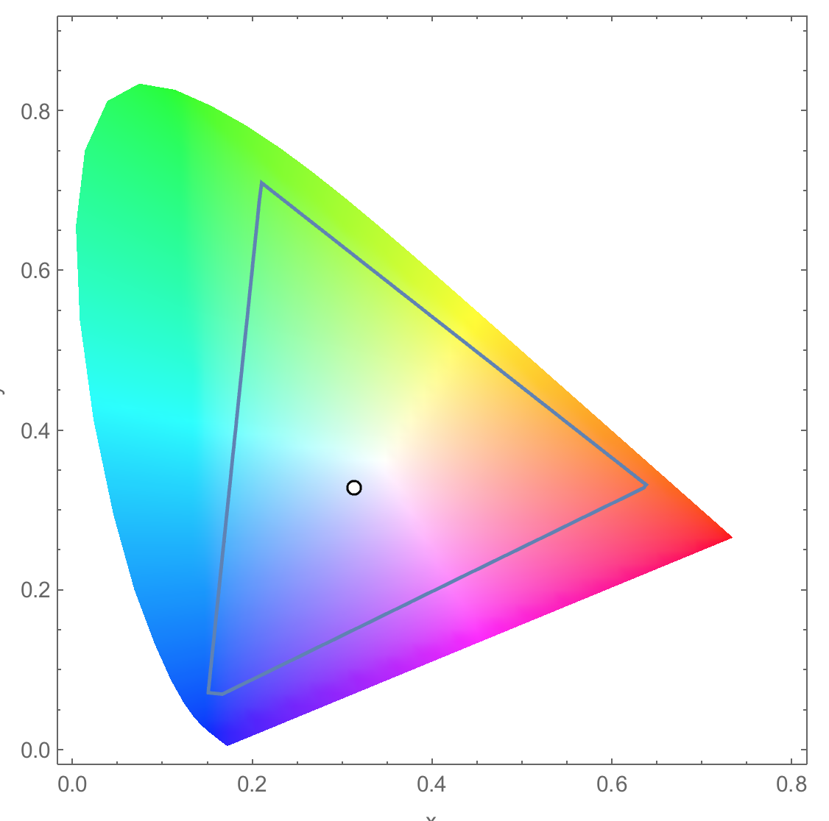
Conversion of a color image to grey–scale image (review)

Slide 9
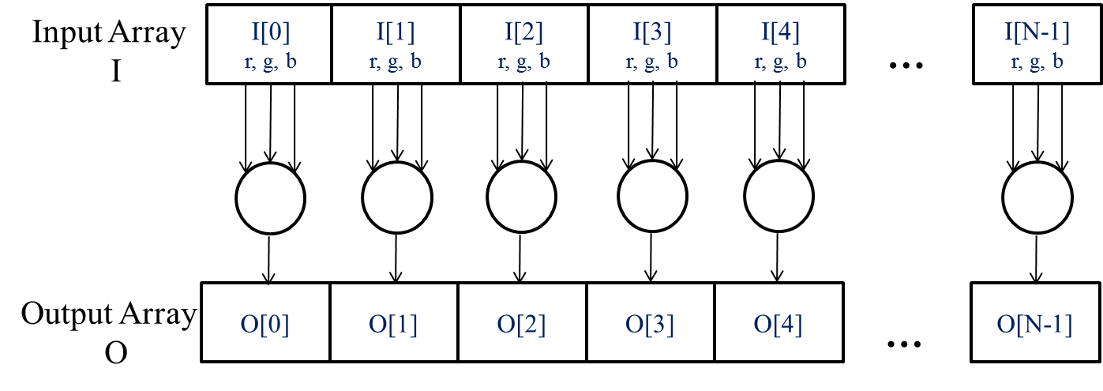
The pixels can be calculated independently of each other (review)

Slide 10
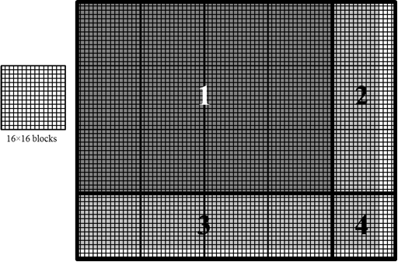
Covering a 76×62 picture with 16×16 blocks
Test (Col < width)

Slide 11
colorToGreyscaleConversion Kernel with 2D thread mapping to data
// we have 3 channels corresponding to RGB
// The input image is encoded as unsigned characters [0, 255]
__global__
void colorToGreyscaleConvertion(unsigned char * grayImage, unsigned char * rgbImage,
int width, int height) {
int Col = threadIdx.x + blockIdx.x * blockDim.x;
int Row = threadIdx.y + blockIdx.y * blockDim.y;
if (Col < width && Row < height) {
// get 1D coordinate for the grayscale image
int greyOffset = Row*width + Col;
// one can think of the RGB image having
// CHANNEL times columns of the gray scale image
int rgbOffset = greyOffset*CHANNELS;
unsigned char r = rgbImage[rgbOffset ]; // red value for pixel
unsigned char g = rgbImage[rgbOffset + 1]; // green value for pixel
unsigned char b = rgbImage[rgbOffset + 2]; // blue value for pixel
// perform the rescaling and store it
// We multiply by floating point constants
grayImage[grayOffset] = 0.21f*r + 0.71f*g + 0.07f*b;
}
}

Slide 12
Row-Major Layout of 2D arrays in C/C++
M_{0,0}
M_{0,1}
M_{0,2}
M_{0,3}
M_{1,0}
M_{1,1}
M_{1,2}
M_{1,3}
M_{2,0}
M_{2,1}
M_{2,2}
M_{2,3}
M_{3,0}
M_{3,1}
M_{3,2}
M_{3,3}
M
M_{0,0}
M_{0,1}
M_{0,2}
M_{0,3}
M_{1,0}
M_{1,1}
M_{1,2}
M_{1,3}
M_{2,0}
M_{2,1}
M_{2,2}
M_{2,3}
M_{3,0}
M_{3,1}
M_{3,2}
M_{3,3}
M
M₀
M₁
M₂
M₃
M₄
M₅
M₆
M₇
M₈
M₉
M₁₀
M₁₁
M₁₂
M₁₃
M₁₄
M₁₅
M_{2,1} → Row*Width+Col = 2*4+1 = 9

Slide 13
colorToGreyscaleConversion Kernel with 2D thread mapping to data (cont.)
// we have 3 channels corresponding to RGB
// The input image is encoded as unsigned characters [0, 255]
__global__
void colorToGreyscaleConvertion(unsigned char * grayImage, unsigned char * rgbImage,
int width, int height) {
int Col = threadIdx.x + blockIdx.x * blockDim.x;
int Row = threadIdx.y + blockIdx.y * blockDim.y;
if (Col < width && Row < height) {
// get 1D coordinate for the grayscale image
int greyOffset = Row*width + Col;
// one can think of the RGB image having
// CHANNEL times columns of the gray scale image
int rgbOffset = greyOffset*CHANNELS;
unsigned char r = rgbImage[rgbOffset ]; // red value for pixel
unsigned char g = rgbImage[rgbOffset + 1]; // green value for pixel
unsigned char b = rgbImage[rgbOffset + 2]; // blue value for pixel
// perform the rescaling and store it
// We multiply by floating point constants
grayImage[grayOffset] = 0.21f*r + 0.71f*g + 0.07f*b;
}
}

Slide 14

Image Blurring

Slide 15
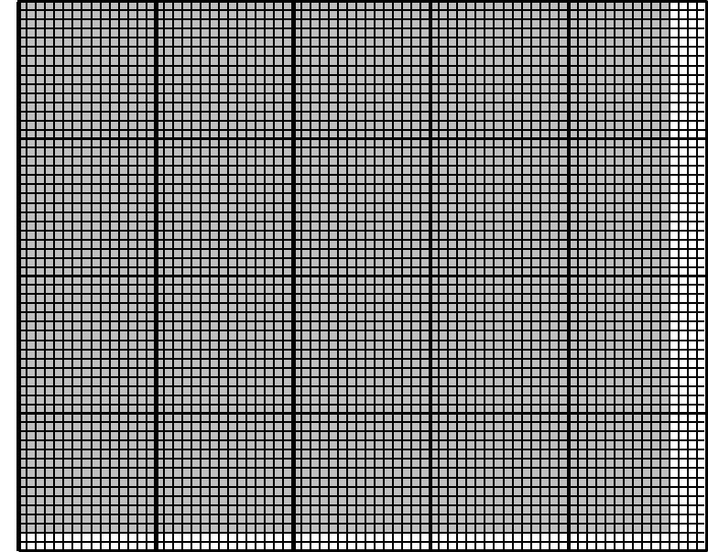
Each output pixel is the average of pixels around it (BLRU_SIZE = 1)
Col
Row

Slide 16
An Image Blur Kernel
__global__
void blurKernel(unsigned char * in, unsigned char * out, int w, int h) {
int Col = blockIdx.x * blockDim.x + threadIdx.x;
int Row = blockIdx.y * blockDim.y + threadIdx.y;
if (Col < w && Row < h) {
1. int pixVal = 0;
2. int pixels = 0;
// Get the average of the surrounding BLUR_SIZE x BLUR_SIZE box
3. for(int blurRow = -BLUR_SIZE; blurRow < BLUR_SIZE+1; ++blurRow) {
4. for(int blurCol = -BLUR_SIZE; blurCol < BLUR_SIZE+1; ++blurCol) {
5. int curRow = Row + blurRow;
6. int curCol = Col + blurCol;
// Verify we have a valid image pixel
7. if(curRow > -1 && curRow < h && curCol > -1 && curCol < w) {
8. pixVal += in[curRow * w + curCol];
9. pixels++; // Keep track of number of pixels in the avg
}
}
}
// Write our new pixel value out
10 out[Row * w + Col] = (unsigned char)(pixVal / pixels);
}
}

Slide 17
Handling boundary conditions for pixels near the edges of the image
3
1
4
2
5

Slide 18
An Image Blur Kernel
__global__
void blurKernel(unsigned char * in, unsigned char * out, int w, int h) {
int Col = blockIdx.x * blockDim.x + threadIdx.x;
int Row = blockIdx.y * blockDim.y + threadIdx.y;
if (Col < w && Row < h) {
1. int pixVal = 0;
2. int pixels = 0;
// Get the average of the surrounding BLUR_SIZE x BLUR_SIZE box
3. for(int blurRow = -BLUR_SIZE; blurRow < BLUR_SIZE+1; ++blurRow) {
4. for(int blurCol = -BLUR_SIZE; blurCol < BLUR_SIZE+1; ++blurCol) {
5. int curRow = Row + blurRow;
6. int curCol = Col + blurCol;
// Verify we have a valid image pixel
7. if(curRow > -1 && curRow < h && curCol > -1 && curCol < w) {
8. pixVal += in[curRow * w + curCol];
9. pixels++; // Keep track of number of pixels in the avg
}
}
}
// Write our new pixel value out
10 out[Row * w + Col] = (unsigned char)(pixVal / pixels);
}
}

Slide 19
CUDA Thread Block (review)
All threads in a block execute the same kernel program (SPMD)
Programmer declares block:
Block size 1 to 1024 concurrent threads
Block shape 1D, 2D, or 3D
Threads have thread index numbers within block
Kernel code uses thread index and block index to select work and address shared data
Threads in the same block share data and synchronize while doing their share of the work
Threads in different blocks cannot cooperate
Each block can execute in any order relative to other blocks!
CUDA Thread Block
Thread Id #: 0 1 2 3 … m
Thread program
Courtesy: John Nickolls, NVIDIA

Slide 20
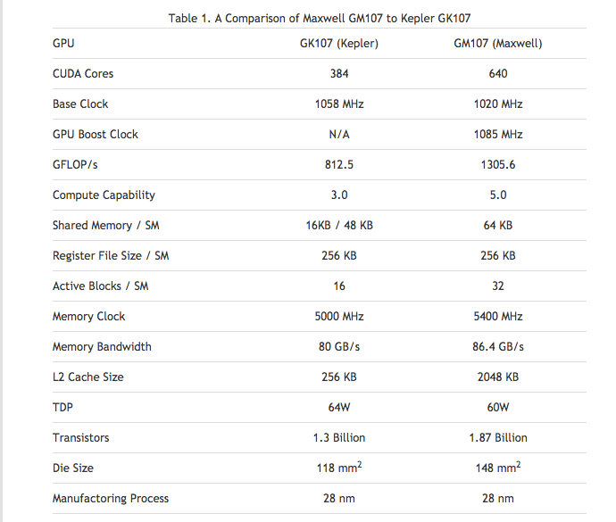
Compute Capabilities are GPU Dependent

Slide 21
Covering a 76×62 picture with 16×16 blocks
Test (Col < width)

Slide 22
Executing Thread Blocks
SM 0
SM 1
t0 t1 t2 … tm
t0 t1 t2 … tm
MT IU
MT IU
Blocks
SP
SP
Threads are assigned to Streaming Multiprocessors in block granularity
Up to 32 blocks to each SM as resource allows in Maxwell
Maxwell SM can take up to 2048 threads
Threads run concurrently
SM maintains thread/block id #s
SM manages/schedules thread execution
Blocks
Shared
Memory
Shared
Memory

Slide 23
Thread Scheduling (1/2)
Each block is executed as 32-thread warps
An implementation decision, not part of the CUDA programming model
Warps are divided based on their linearized thread index
Threads 0-31: warp 0
Threads 32-63: warp 1, etc.
Warps are scheduling units in SM
If 3 blocks are assigned to an SM and each block has 256 threads, how many warps are there in an SM?
Each block is divided into 256/32 = 8 warps
8 warps/blk * 3 blks = 24 warps
…
Block 1 Warps
…
Block 2 Warps
…
Block 1 Warps
…
…
…
t0 t1 t2 … t31
t0 t1 t2 … t31
t0 t1 t2 … t31
Register File
(128 KB)
L1
(16 KB)
Shared Memory
(48 KB)

Slide 24
Thread Scheduling (2/2)
SM implements zero-overhead warp scheduling
Warps whose next instruction has its operands ready for consumption are eligible for execution
Eligible warps are selected for execution on a prioritized scheduling policy
All threads in a warp execute the same instruction when selected
Example execution timing of an SM

Slide 25
Control (branch) Divergence
Main performance concern with branching is divergence
Threads within a single warp take different paths
Different execution paths are serialized in current GPUs
The control paths taken by the threads in a warp are traversed one at a time until there is no more.
A common case: divergence could occur when branch condition is a function of thread ID
Example with divergence:
If (threadIdx.x > 2) { }
This creates two different control paths for threads in a block
Branch granularity < warp size; threads 0, 1 and 2 follow different path than the rest of the threads in warp 0
Example without divergence:
If (threadIdx.x / WARP_SIZE > 2) { }
Also creates two different control paths for threads in a block
Branch granularity is a whole multiple of warp size; all threads in any given warp follow the same path
Notes:
WARP_SIZE

Slide 26
Block Granularity Considerations
For colorToGreyscaleConversion, should one use 8X8, 16X16 or 32X32 blocks? Assume that in the GPU used, each SM can take up to 1,536 threads and up to 8 blocks.
For 8X8, we have 64 threads per block. Each SM can take up to 1536 threads, which is 24 blocks. But each SM can only take up to 8 Blocks, only 512 threads (16 warps) will go into each SM!
For 16X16, we have 256 threads per block. Since each SM can take up to 1,536 threads (48 warps), which is 6 blocks (within the 8 block limit). Thus we use the full thread capacity of an SM.
For 32X32, we would have 1,024 threads per Block. Only one block can fit into an SM, using only 2/3 of the thread capacity of an SM.

